Slide 1

CAP 6317/4773: Social Media Mining
Lecture 6: Statistical Properties of Networks
Raiyan Abdul Baten, Ph.D.
January 25, 2024

Slide 2
Recap

Slide 3
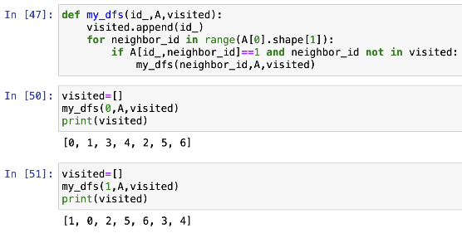
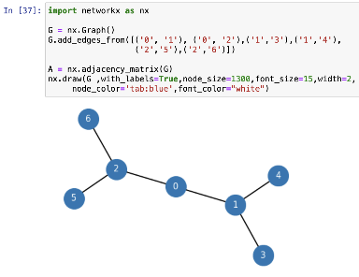

Slide 4
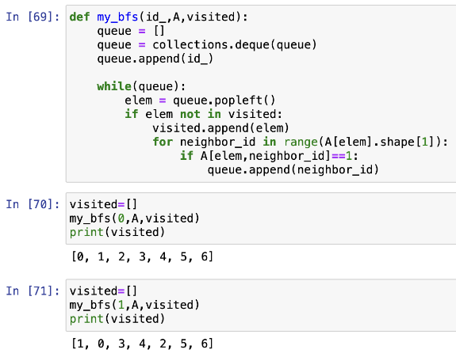


Slide 5
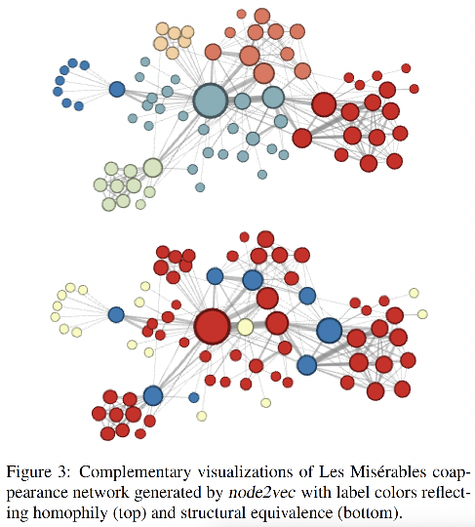
Which nodes are similar to each other?

Slide 6
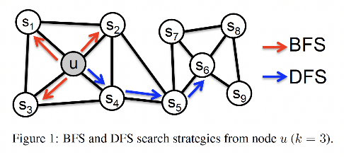
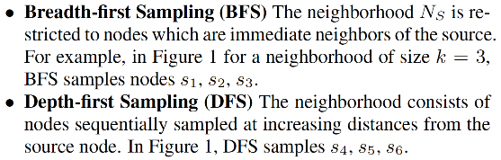

Slide 7
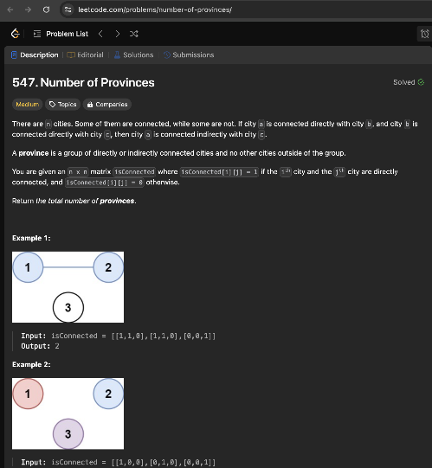

Slide 8
Reminder to self: Attendance

Slide 9
Note for everyone: Extension Tokens

Slide 10
Readings for Today’s Lecture: 3.2, 3.3, 3.4

Slide 11
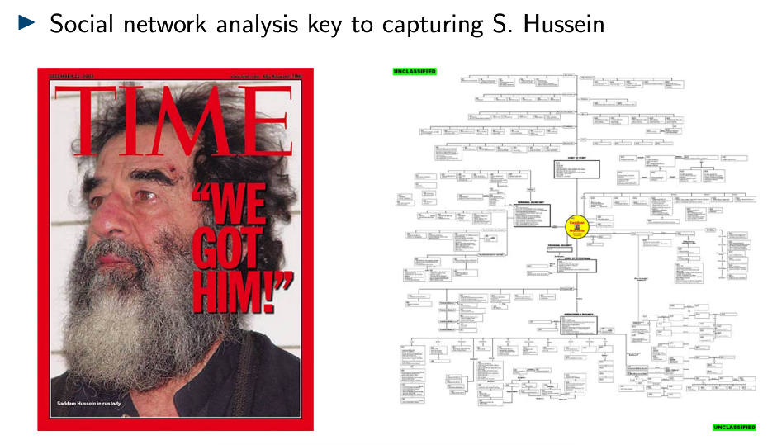

Slide 12
Node Similarity

Slide 13
Which nodes are similar to each other?

Slide 14
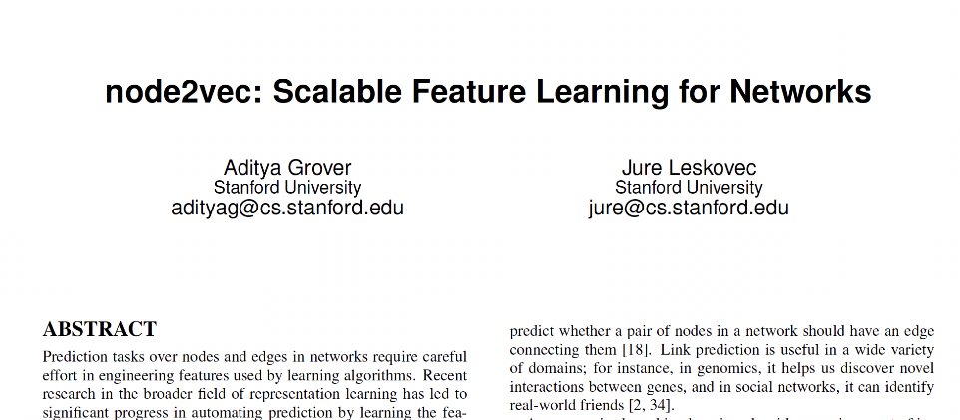

Slide 15
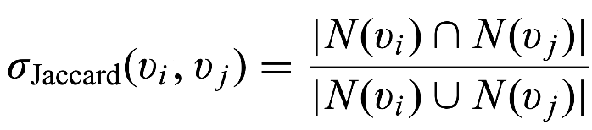

Capturing Structural Equivalence
N is the set of neighboring nodes

Slide 16
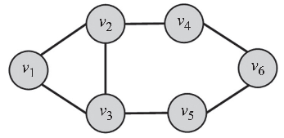
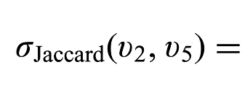
Capturing Structural Equivalence

Slide 17
Capturing Structural Equivalence
N(v₂) = {v₁, v₃, v₄}

Slide 18

Capturing Structural Equivalence
N(v₂) = {v₁, v₃, v₄}
N(v₅) = {v₃, v₆}

Slide 19
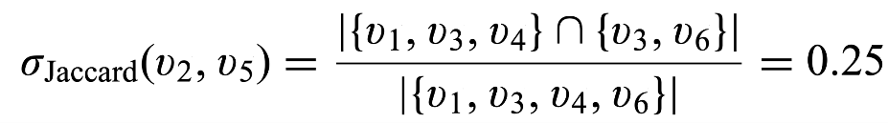
Capturing Structural Equivalence
N(v₂) = {v₁, v₃, v₄}
N(v₅) = {v₃, v₆}

Slide 20
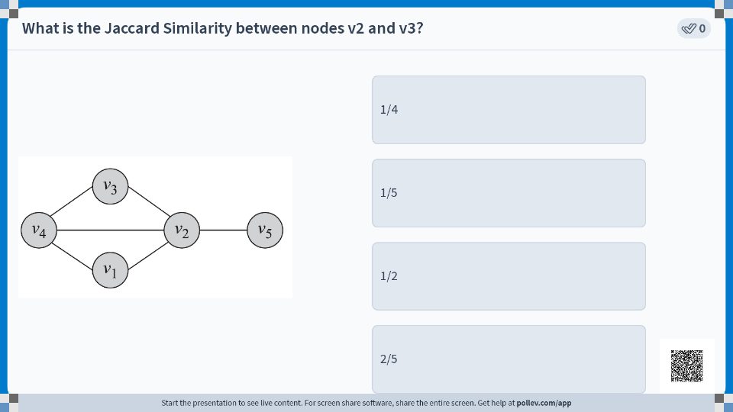

Slide 21
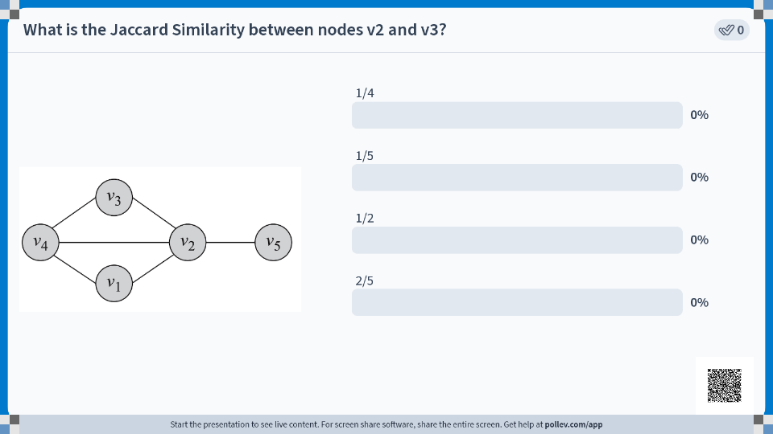

Slide 22
Transitivity and Clustering Coefficient

Slide 23
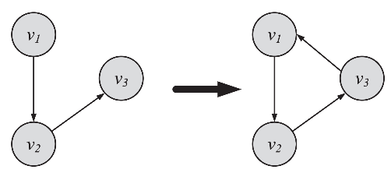
Transitive Linking
When a friend of my friend is my friend

Slide 24
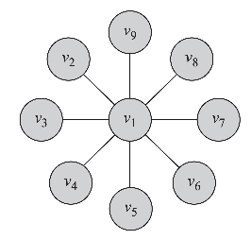
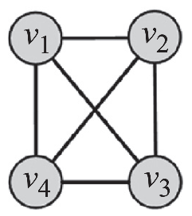
Data Mining Task: How Prevalent is Transitivity in your Data?
No triangle is closed
Clustering Coeff = 0
Example: Star Graph
All triangles are closed
Clustering Coeff = 1
Example: Fully Connected Graph

Slide 25
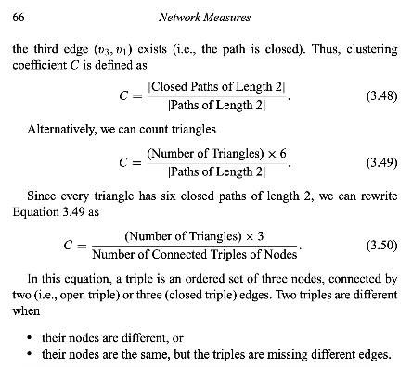

Slide 26


Slide 27
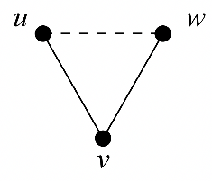
Two ways of calculating the Clustering Coefficient
1. Clustering Coefficient in terms of ‘Paths’
A ‘path’ is a sequence of incident, distinct edges that connect distinct nodes.
(u,v) and (v,w) lead to the path uvw
If (u,w) exists, we say the path uvw is closed

Slide 28
Two ways of calculating the Clustering Coefficient
1. Clustering Coefficient in terms of ‘Paths’
A ‘path’ is a sequence of incident, distinct edges that connect distinct nodes.
(u,v) and (v,w) lead to the path uvw
If (u,w) exists, we say the path uvw is closed
However, a path has directions, even in an undirected graph
The path uvw is different from the path wvu
Two paths that traverse the same edges but in opposite directions are counted separately

Slide 29

Two ways of calculating the Clustering Coefficient
1. Clustering Coefficient in terms of ‘Paths’

Slide 30
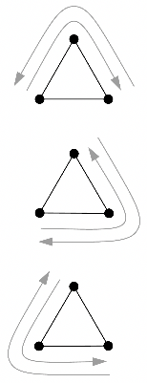

Two ways of calculating the Clustering Coefficient
1. Clustering Coefficient in terms of ‘Paths’

Slide 31
Two ways of calculating the Clustering Coefficient
1. Clustering Coefficient in terms of ‘Paths’
Each triangle has 6 closed ‘paths’

Slide 32
Two ways of calculating the Clustering Coefficient
2. Clustering Coefficient in terms of ‘Connected Triples’
A ‘connected triple’ has two edges coming out of a center node
v is the center node. (u,v) and (v,w) are connected to v.
So uvw is a connected triple.

Slide 33
Two ways of calculating the Clustering Coefficient
2. Clustering Coefficient in terms of ‘Connected Triples’
A ‘connected triple’ has two edges coming out of a center node
v is the center node. (u,v) and (v,w) are connected to v.
So uvw is a connected triple.
A connected triple has no direction!

Slide 34

Two ways of calculating the Clustering Coefficient
2. Clustering Coefficient in terms of ‘Connected Triples’

Slide 35
Two ways of calculating the Clustering Coefficient
2. Clustering Coefficient in terms of ‘Connected Triples’
A triangle can have 3 connected triples, one centered at each node:
uvw, vwu, and wuv.

Slide 36
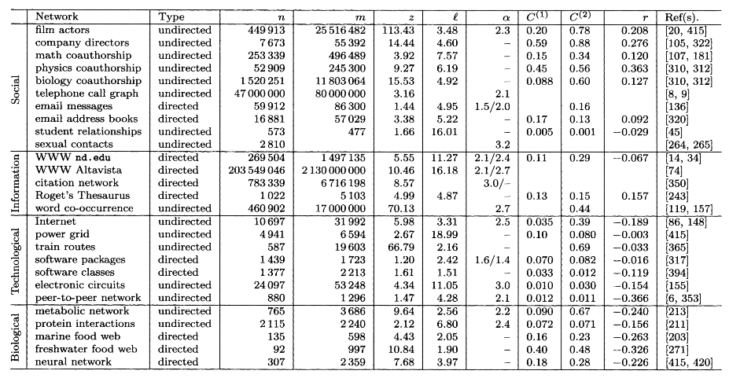
Newman, Mark EJ. "The structure and function of complex networks." SIAM Review 45.2 (2003): 167-256.

Slide 37
If the collaborations happened randomly, we would a very small C = 0.0003
Why? Imagine everyone has 500 friends on Facebook. If those friends are randomly chosen from a 2B node global network, hardly any triangles would close, and C would be really low.
A high C in real social data suggests that our connection patterns are far from random!
Newman, Mark EJ. "The structure and function of complex networks." SIAM Review 45.2 (2003): 167-256.

Slide 38
Building a Peer Recommendation Engine
Please don’t recommend me random people to befriend :/

Slide 39
Building a Peer Recommendation Engine
Please don’t recommend me random people to befriend :/
Intuitive Heuristic: Close the triangle!
Recommend u and w to befriend each other

Slide 40
Building a Content Recommendation Engine
Please don’t recommend me random movies to watch :/
An edge exists because u and v both watched The Godfather
An edge exists because v and w both watched Titanic

Slide 41
Building a Content Recommendation Engine
Please don’t recommend me random movies to watch :/
Intuitive Heuristic: Close the triangle!
Recommend The Godfather to w and Titanic to u
An edge exists because u and v both watched The Godfather
An edge exists because v and w both watched Titanic

Slide 42
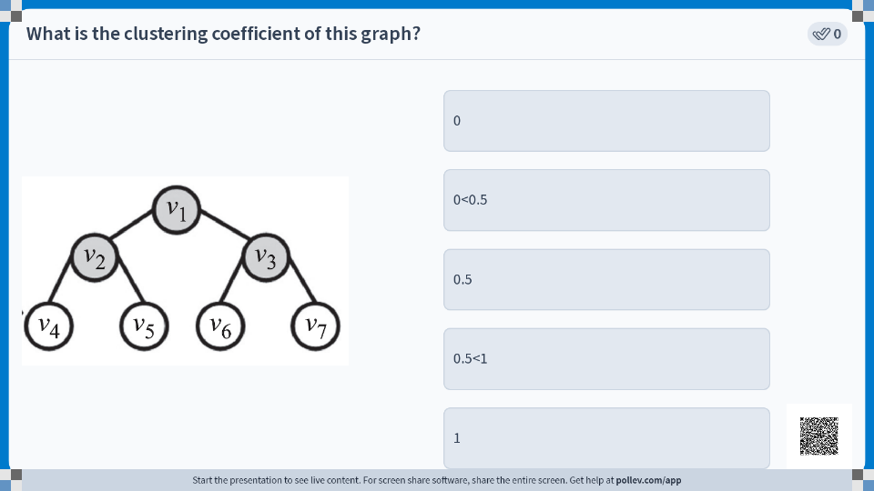

Slide 43
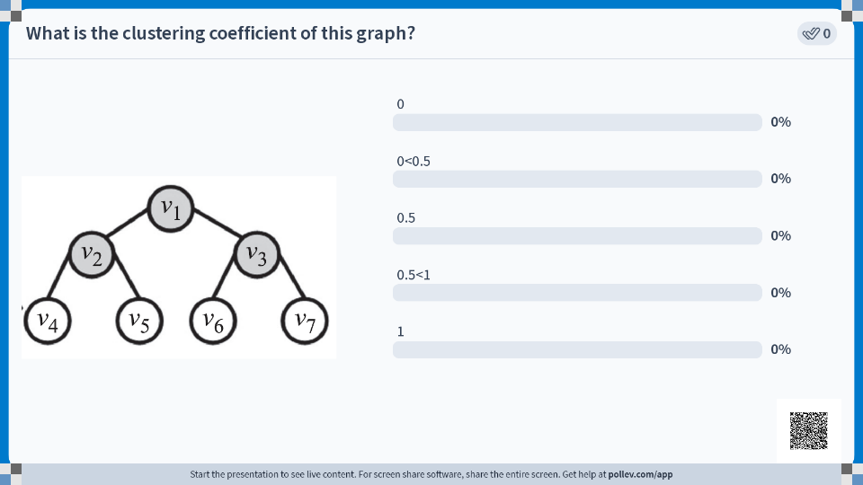

Slide 44
Local Clustering Coefficient

Slide 45
Local Clustering Coefficient
To what extent are my friends, friends with each other?
v_{i}

Slide 46
Local Clustering Coefficient
To what extent are my friends, friends with each other?
v_{i} has k_{i} = 3 friends
v_{i}

Slide 47
Local Clustering Coefficient
To what extent are my friends, friends with each other?
v_{i} has k_{i} = 3 friends
k_{i} nodes can have at most (k_{i} choose 2) pairwise connections among them
v_{i}

Slide 48
Local Clustering Coefficient
To what extent are my friends, friends with each other?
v_{i} has k_{i} = 3 friends
k_{i} nodes can have at most (k_{i} choose 2) pairwise connections among them
Here, ³C₂ = 3, so there are 3 potential pairwise connections among v_{i}’s friends
v_{i}

Slide 49

Local Clustering Coefficient
To what extent are my friends, friends with each other?
v_{i} has k_{i} = 3 friends
k_{i} nodes can have at most (k_{i} choose 2) pairwise connections among them
Here, ³C₂ = 3, so there are 3 potential pairwise connections among v_{i}’s friends
The fraction of potential pairwise connections that actually exist is the Local Clustering Coefficient
v_{i}

Slide 50

Local Clustering Coefficient
To what extent are my friends, friends with each other?
v_{i} has k_{i} = 3 friends
k_{i} nodes can have at most (k_{i} choose 2) pairwise connections among them
Here, ³C₂ = 3, so there are 3 potential pairwise connections among v_{i}’s friends
The fraction of potential pairwise connections that actually exist is the Local Clustering Coefficient
v_{i}

Slide 51
Local Clustering Coefficient
To what extent are my friends, friends with each other?
v_{i}
C(v_{i}) = 0

Slide 52
Local Clustering Coefficient
To what extent are my friends, friends with each other?
v_{i}
v_{i}
C(v_{i}) = 0
C(v_{i}) = 1/3

Slide 53
Local Clustering Coefficient
To what extent are my friends, friends with each other?
v_{i}
v_{i}
v_{i}
C(v_{i}) = 0
C(v_{i}) = 1/3
C(v_{i}) = 2/3

Slide 54
Local Clustering Coefficient
To what extent are my friends, friends with each other?
v_{i}
v_{i}
v_{i}
v_{i}
C(v_{i}) = 0
C(v_{i}) = 1/3
C(v_{i}) = 2/3
C(v_{i}) = 1

Slide 55
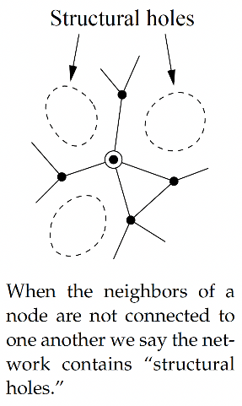

Slide 56
If your local clustering coefficient is low, you will have many structural holes around you, and you will have a ‘broker’ role.
Another way of capturing betweenness centrality, but at a local level

Slide 57
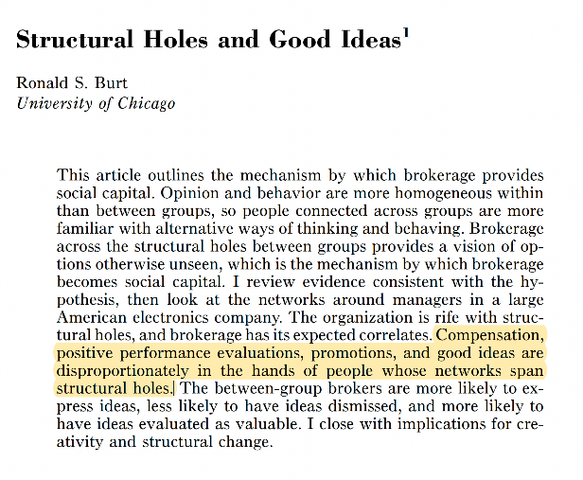

Slide 58
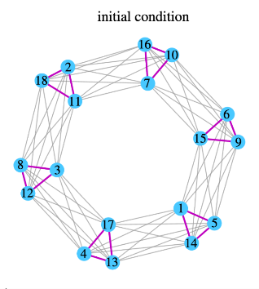
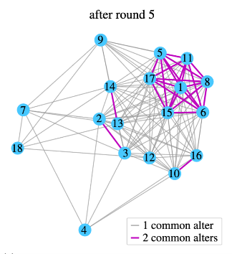
As networks grow more clustered, ideas grow more redundant
Baten, Raiyan Abdul, et al. "Creativity in temporal social networks: How divergent thinking is impacted by one’s choice of peers." Journal of the Royal Society Interface 17.171 (2020): 20200667.

Slide 59
Social Balance Theory

Slide 60


Slide 61
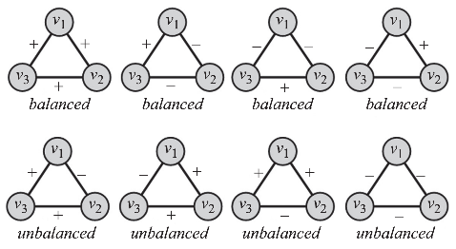
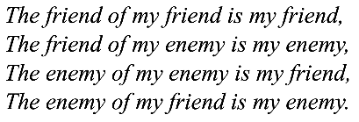
Social Balance Theory

Slide 62
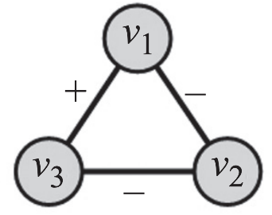
Does your data show Social Balance?

Slide 63
Does your data show Social Balance?
w₁₃= +1
w₂₁= -1
w₃₂= -1

Slide 64

Does your data show Social Balance?
We have social balance if
w₁₃= +1
w₂₁= -1
w₃₂= -1

Slide 65
Degree Distributions

Slide 66
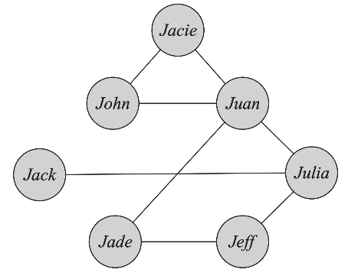

Slide 67


Slide 68
Summary

